Slide 1
Comparing Water Usage Proportions: USA vs Spain (2000–2024)
Group Members: Elizabeth Huevler, Ben Schweitzer, Manasi Ambedkar, Sanchith Devarajan

Slide 2
Research Question
Are there differences in the average proportions of total water allocated to agriculture, industry, and households between the USA and Spain over the years 2000-2024?

Slide 3
Data & Variables
Source: Kaggle’s Global Water Consumption Dataset (2000–2024)
Countries Focused On: USA and Spain
Sectors Analyzed:
1. Agricultural Use
2. Industrial Use
3. Household Use
Variables: Country, Year, and Proportion of water usage by sector

Slide 4
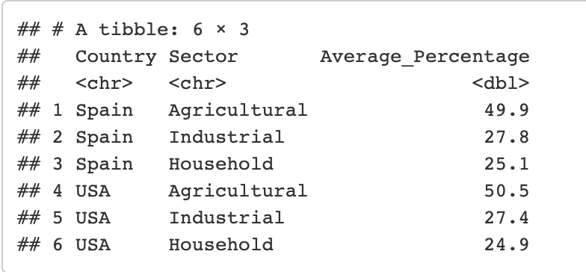
Data Processing
Filtered to USA and Spain (2000–2024)
No missing data – clean dataset
Averaged water proportions across sectors for both countries

Slide 5
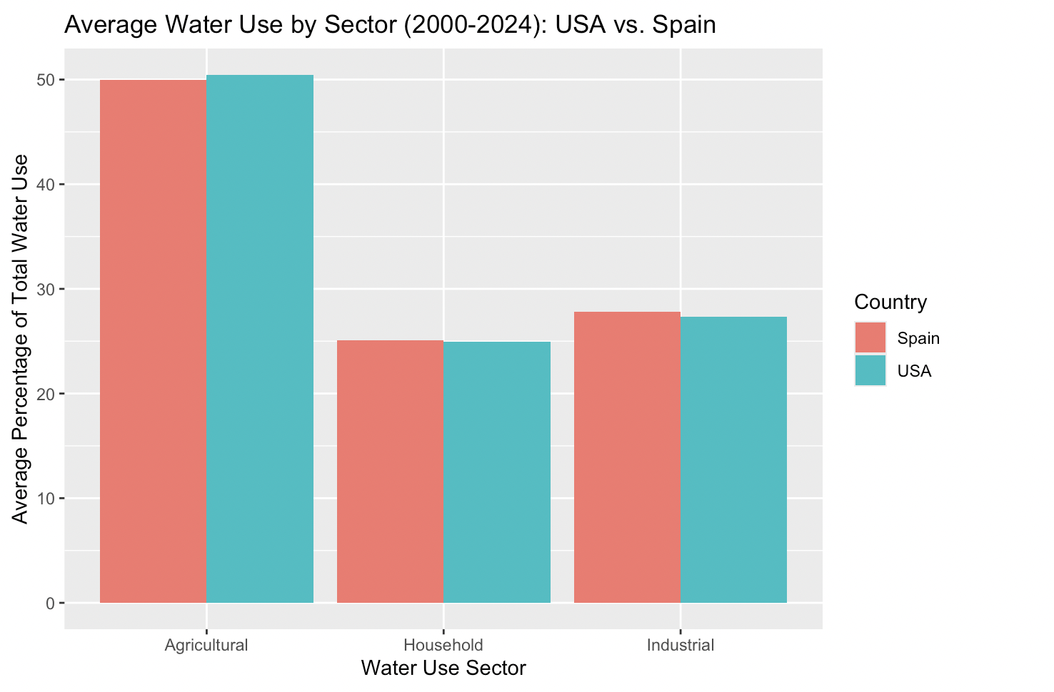
Visualization
Average water use by sector
USA and Spain show similar distribution
Visually confirms minimal difference

Slide 6
Statistical Methodology
Goal: Compare mean water use proportions across countries
Tool: Two-sample t-tests
One test per sector
Assumptions:
1. Independent samples
2. Approximate normality
3. Constant variance

Slide 7
Hypotheses
For each sector:
- H₀: Mean proportion (USA) = Mean proportion (Spain)
- Hₐ: Mean proportion (USA) ≠ Mean proportion (Spain)
Chosen significance level, α = 0.05

Slide 8
Test Results
Sector | Test stat | P-value | Decision
Agriculture | -0.368 | 0.714 | Fail to reject H₀
Industry | 0.362 | 0.719 | Fail to reject H₀
Household | 0.199 | 0.843 | Fail to reject H₀
No significant difference in any sector

Slide 9
Confidence Intervals
sector | 95% CI
Agriculture | [-3.26, 2.25]
Industry | [-1.93, 2.77]
Household | [-1.58, 1.92]
All intervals include 0 → results align with t-tests

Slide 10
Interpretation
High p-values = no strong evidence of a difference
If CI contains 0 →there is no clear difference
Conclusion: Water usage patterns in USA and Spain are statistically similar.

Slide 11
Limitations
Data is synthetic (not real-world verified)
Only 2 countries analyzed
Only 25 years of data
Sector definitions may differ across countries

Slide 12
Future Steps
Use real-world data
Include more countries (e.g., developing nations)
Analyze longer timeframes
Explore water use trends over time

